Slide 1
Cumulative Frequency
and Box Plots

Slide 2
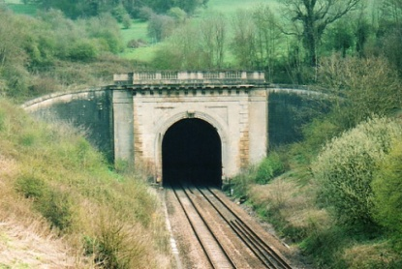
Starter
A Golf club conducts a survey of its members. The ages of those who completed it are in the table below.
a) Plot a Cumulative Frequency curve of the information
b) Use it to work out the Median, Lower Quartile and Upper Quartile. What is the Inter-Quartile Range?
0≤a<20
20≤a<40
40≤a<60
60≤a<80
80≤a<100
Frequency
7
18
31
23
1
C. Freq.
7
25
56
79
80

Slide 3
Starter
CF (People)
A Golf club conducts a survey of its members. The ages of those who completed it are in the table below.
b) Use it to work out the Median, Lower Quartile and Upper Quartile. What is the Inter-Quartile Range?
100
80
UQ
60
 | 0-20 | 20-40 | 40-60 | 60-80 | 80-100
CF | 7 | 25 | 56 | 79 | 80
Median
40
LQ
20
IQR
0
0
20
40
60
80
100
Median = 50
LQ= 36
UQ= 62
IQR= 26
Age

Slide 4
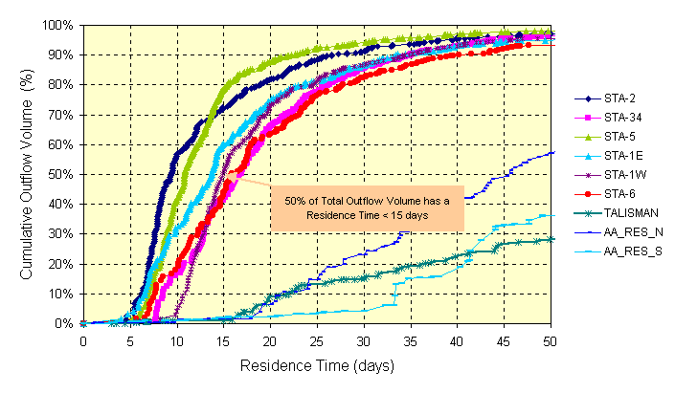
Cumulative Frequency and Box Plots
We have covered plotting a Cumulative Frequency graph
We have learnt how to interpret the graph
We now know how to work out the Median, Lower and Upper Quartiles, as well as the Inter-Quartile range
Today we will be plotting box plots, which are a way of ‘summarising’ the spread of data

Slide 5
Cumulative Frequency and Box Plots
This is the table of ages at a Golf club, that we used in the starter.
 | 0-20 | 20-40 | 40-60 | 60-80 | 80-100
CF | 7 | 25 | 56 | 79 | 80
We also worked out the following:
Median = 50
Lower Quartile = 36
Upper Quartile = 62
We need 2 more pieces of information to plot a box plot;
Lowest possible value
Highest possible value
0
100

Slide 6
Cumulative Frequency and Box Plots
We know;
Lowest Possible Value = 0
Highest Possible Value = 100
Median = 50
Lower Quartile = 36
Upper Quartile = 62
Middle 50%
25%
25%
25%
25%
0
20
40
60
80
100

Slide 7
Cumulative Frequency and Box Plots
Plot a box plot for this information.
Lowest Possible Value = 20
Highest Possible Value = 100
Median = 40
Lower Quartile = 30
Inter-Quartile Range = 34
Middle 50%
25%
25%
25%
25%
0
20
40
60
80
100

Slide 8
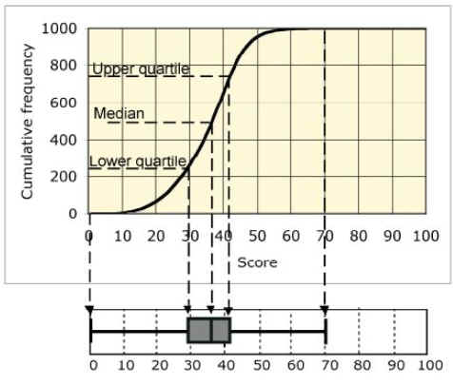
Cumulative Frequency and Box Plots
This picture illustrates how the Cumulative Frequency Curve and the Box plot ‘link together’

Slide 9
Cumulative Frequency and Box Plots
Compare these two box plots, showing battery life (in hours)
Flying bug
Ever Steady
6
8
10
12
14
16
Use the Median and Interquartile Range
→ The Median for both is very similar, just over 11, so each type of battery last around 11 hours ‘on average’
→ Flying bug has a much lower Interquartile range. This means it is more consistent as 50% of its batteries are spread over a smaller range of times.

Slide 10
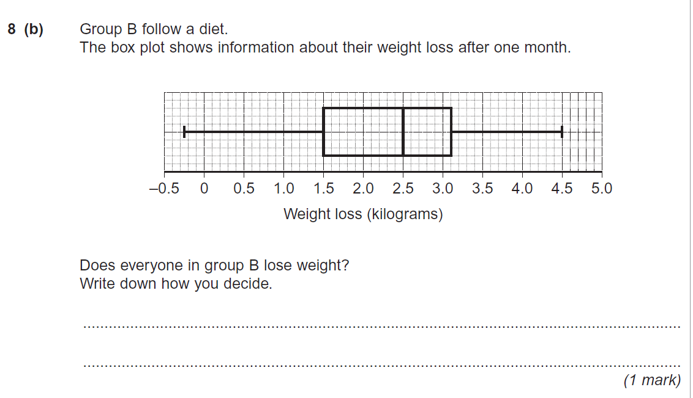
Plenary
No, some ‘lost’ a Negative amount of weight, which implies it was actually a gain.

Slide 11
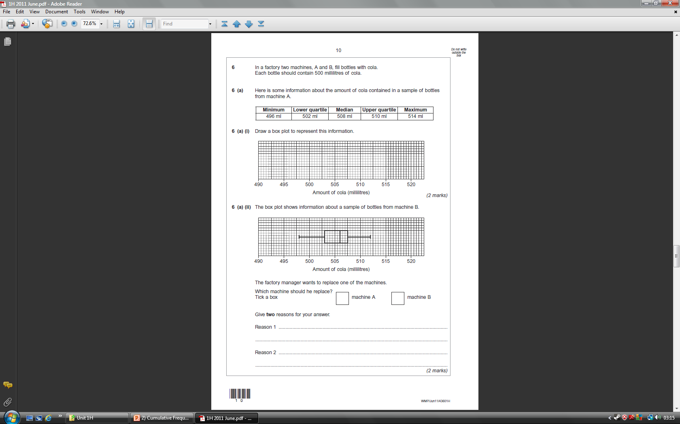
Plenary

Slide 12
Plenary
Reason 1:
Although A has a higher median, the bottles should contain 500ml, so B ‘wastes’ less cola. A wastes more and should be replaced
Reason 2:
A has a higher interquartile range and is therefore less consistent when filling the bottles up

Slide 13
Summary
We have recapped working out the Median, Lower and Upper Quartiles
We have also looked again at the Inter-Quartile Range
We have used this information to help us draw box plots and interpret them

